Slide 1
WSN@work LED-node 2.0 Jo Simons

Slide 2
What’s the target
Build a LED node which
supports multiple commands to a LED
sends feedback with actual LED status
sends periodic updated counter
Configure OpenHab with
command buttons iso an on/off switch
live LED status based on node feedback
Provide cross-platform MQTT client for testing
Based on wireless MySensorsGateway

Slide 3
End-2-end view

Slide 4
LED node 2.0
This node accepts following commands:
value 2: turn LED on
value 3: turn LED off
value 6: toggle LED
value 9: start LED blinking
This node will send:
new counter value every second
current LED state when this is changed (0=off,1=on)

Slide 5
Arduino code 1/5
Variables and defines
#include <DigitalIO.h>
#include <DigitalPin.h>
#include <MySensor.h>
#include <SPI.h>
#define CNT_ID 0 // counter sensor id
#define LED_ID 1 // LED sensor id
#define LED_PIN 2 // LED pin
#define LED_OFF 0 // LED off state
#define LED_ON 1 // LED on state
#define LED_BLINK 2 // LED blinking indicator, ored with state
#define NODE_ID 31 // CHANGE TO YOUR NODE-ID !!!
MySensor gw;
MyMessage eventMsg(CNT_ID, V_VOLUME);
MyMessage statusMsg(LED_ID, V_LIGHT);
unsigned long lastUpdate = 0;
int cntValue = 0;
int ledState = LED_OFF;

Slide 6
Arduino code 2/5
Initialise the node
void setup() {
Serial.begin(115200);
Serial.println("start serial");
// startup and initialize MySensors library.
gw.begin(handleIncMsg, NODE_ID, false);
gw.sendSketchInfo("ledNode", "2.0");
gw.present(CNT_ID, S_WATER); // -> V_VOLUME
gw.present(LED_ID, S_LIGHT); // <> V_LIGHT
// initialize the LED with reloaded state from EEPROM
pinMode(LED_PIN, OUTPUT);
setLED(ledState = gw.loadState(LED_ID));
Serial.println("init done");
gw.process();
} // setup

Slide 7
Arduino code 3/5
Set LED and send feedback
void setLED(int nState) {
// write to output
digitalWrite(LED_PIN, nState & LED_ON);
// send on/off feedback to gateway
gw.send(statusMsg.setSensor(LED_ID).set(nState & LED_ON));
// save full state to EEPROM and report
gw.saveState(LED_ID, nState);
Serial.print("LED state=");
Serial.println(nState);
} // setLED

Slide 8
Arduino code 4/5
Periodical processing
void loop(){
unsigned long now = millis();
if ((now - lastUpdate) > 1000) {
// update counter every second
gw.send(eventMsg.setSensor(CNT_ID).set(++cntValue));
Serial.println(cntValue);
lastUpdate = now;
// handle blinking LED
if (ledState & LED_BLINK)
setLED(ledState = ((ledState & LED_ON) ? LED_OFF : LED_ON) | LED_BLINK);
}
// Alway process messages whenever possible
gw.process();
} // loop

Slide 9
Arduino code 5/5
Handling command from controller
void handleIncMsg(const MyMessage &incMsg) {
if ((incMsg.type == V_LIGHT) && (incMsg.sensor == LED_ID)) {
Serial.print("LED command=");
Serial.print(incMsg.getInt());
switch (incMsg.getInt()) {
case 2: ledState = LED_ON;
break;
case 3: ledState = LED_OFF;
break;
case 6: ledState = (ledState & LED_ON) ? LED_OFF : LED_ON;
break;
case 9: ledState = ((ledState & LED_ON) ? LED_OFF : LED_ON) | LED_BLINK;
break;
default: Serial.print("... unknown command");
break;
} // switch
Serial.println("");
setLED(ledState);
}
} // handleIncMsg

Slide 10
Wireless GW MQTT Settings
Goto http://<ip-address-of-gateway>/mqttconfig
From sensor prefix: evtMQTT
messages coming from the LED node will be published as:
evtMQTT/<node>/<sensor>/<type>=<val>
samples:
evtMQTT/31/0/V_VOLUME=1234
evtMQTT/31/1/V_LIGHT=0
From controller prefix: cmdMQTT
the GW will subscribe to cmdMQTT/* topics
published messages are passed through to the LED node:
cmdMQTT/31/1/V_LIGHT=2 turns LED on
cmdMQTT/31/1/V_LIGHT=3 turns LED off
cmdMQTT/31/1/V_LIGHT=6 toggles LED
cmdMQTT/31/1/V_LIGHT=9 starts LED blinking

Slide 11
OpenHab Configuration 1/3
Items
defined in: configurations/items/test.items
structured naming: node<node-id>_<sensor-type><sensor-id>
i.e. node31_cnt0, node31_led1, node31_fb1
we define 3 items
node31_cnt0 for the counter that is updated every second
node31_fb1 for receiving the feedback of actual LED state
node31_out1 for controlling the LED, describing all supported commands
Number node31_cnt0 " [%d]" { mqtt="<[mysensor:evtMQTT/31/0/V_VOLUME:state:default]" }
Number node31_fb1 " [%d]" { mqtt="<[mysensor:evtMQTT/31/1/V_LIGHT:state:default]" }
Switch node31_out1 "" { autoupdate="false“, mqtt=">[mysensor:cmdMQTT/31/1/V_LIGHT:command:ON:2],>[mysensor:cmdMQTT/31/1/V_LIGHT:command:OFF:3],>[mysensor:cmdMQTT/31/1/V_LIGHT:command:TOGGLE:6] ,>[mysensor:cmdMQTT/31/1/V_LIGHT:command:BLINK:9]" }

Slide 12
OpenHab Configuration 2/3
Sitemap
defined in: configurations/sitemaps/default.sitemap
describes the layout of the UI
uses a Text field to display the periodic timer update
uses a Switch field with mappings to display the 3 command buttons
OpenHab implied behaviour of Toggle !!!
Text label="Simonjo" icon="boy0" {
Frame {
Text item=node31_cnt0 label="cnt0 [%d]" icon="calendar"
Switch item=node31_out1 label="out1" icon="light" mappings=[ON="On", OFF="Off", TOGGLE="Toggle"]
}
}

Slide 13
OpenHab Configuration 3/3
Rule
defined in: configurations/rules/test.rules
converts the update received for item ‘node31_fb1’ into an update for the icon of item ‘node31_out1’
// map LED node feedback onto icon
rule "node31_fb1"
when
Item node31_fb1 received update
then
node31_out1.postUpdate(if(node31_fb1.state.toString == "1") ON else OFF)
end

Slide 14
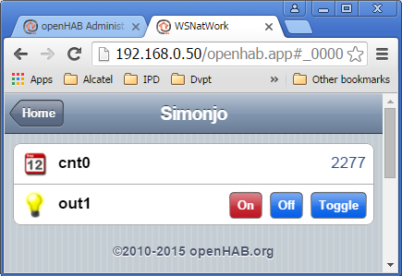
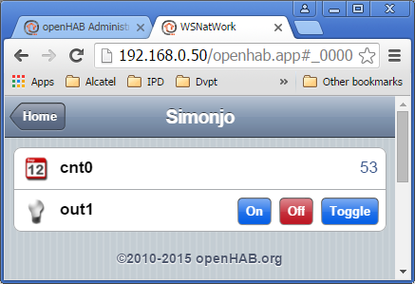
OpenHab GUI
Previous configuration will result in this GUI

Slide 15
MQTT client for testing
Cross platform
Windows xmqttc.exe
Linux on x86 xmqttc.x86
RaspberryPi (ARM) xmqttc.raspi
Onion Omega (MIPS) xmqttc.onion
Get help: ./xmqtt.raspi -?
Important to specify unique --clientid <clientid>
And to specify target MQTT broker with --remaddr <ip-addr>
Sample usage:
./xmqttc.raspi --clientid simonjo --remaddr <ip-addr-broker> cmdMQTT/31/1/V_LIGHT=6

